Slide 1
Great Bentley Village Green
Southside Project
Illustrative Slides for Discussion
March 2024
clerk@greatbentleyparishcouncil.co.uk
01206 256410

Slide 2
Southside Track West
What is Proposed and Why
Since 2013 approx. 50% of the 460 approved Planning Applications have been built. Although ECC Highways imposed conditions, all applications were agreed, as Highways considered the local road network would cope with the increase in traffic.
The Parish Council at the time objected to the Planning Applications, citing traffic levels and lack of infrastructure.
Statistically about an additional 120 vehicle movements have been added within the Village at the peak hours (7-8am & 5-6pm), added to which, is the increase in through traffic and development construction vehicles. Vehicle movements are expected to double within the next 3 or 4 years when all developments have been completed.
What is proposed for Southside Track | Why is this necessary
A tarmac-based re-surfacing of the western side of Southside track (between junction of Station Road to the concrete tracks that lead to Weeley Road) This will not intended to become an adopted road. It will remain Village Green A vehicle barrier (swing gate) will be positioned on the track to prevent through traffic between Weeley Rd and Station/Plough Rd The vehicle barrier will not impact pedestrian and mobility access along southside track Approximately 90m of Timber bollards will be positioned parallel to southside track west to deter through traffic driving onto the Village Green to by-pass the vehicle barrier A turning head will be positioned near to the vehicle barrier to allow larger vehicles such as the Refuse Truck to turn-around rather than reverse for 200 meters A request for donations from Southside East residents to be completely discretionary | The Parish Council is responsible for the maintenance of The Green, which includes all the tracks (they are registered as Village Green not roads or tracks). The Parish Council must abide by the laws protecting the Village Green whilst also ensuring that the Village Green is a safe and useable facility for recreation and sports, therefore the intention of this proposal is solely about protecting our wonderful Village Green from continued damage. Parking throughout the Village, particularly Plough Road and Heckfords Road has increased markedly in the last five years. Vehicles are taking shortcuts through the Village to avoid bottlenecks by using the Southside track and past the pond. The Southside track and the edge of the grassed area has suffered significant deterioration primarily caused by vehicles repeatedly driving onto the Village Green to avoid the poor track surface, potholes and standing water. Prevent mud and potholes and supress dust in dry months Efforts to protect the Village Green through repairs to the Southside track are ineffective for the longer-term protection of the Village Green Maintenance of the tracks, primarily Southside track is circa £6K. Increased traffic and poor weather shortens the time between required maintenance. Temporary maintenance cannot be sustained, and Parish funds would be better directed towards a more effective, longer-term surfacing solution. A solution to protect the grassed area by improving the Southside track will necessitate restricting traffic, limit access onto the Green and improve the track surface in a “spend to save” measure. Whilst the proposal aims to protect and preserve the Village Green from deterioration there is a concurrent benefit to all those using the surface
2

Slide 3
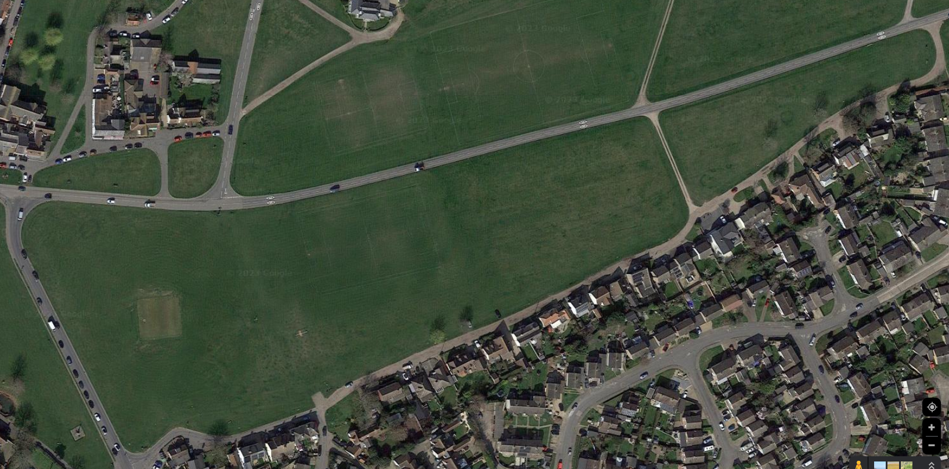
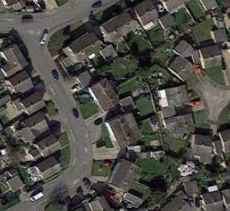
Southside Project
Location Details
HECKFORDS Rd
NORTHSIDE VILLAGE GREEN
southside track east
WEELEY Rd
concrete strip
THORRINGTON Rd
SOUTHSIDE VILLAGE GREEN
southside track west
PLOUGH Rd
BIRCH Ave
STATION Rd
3

Slide 4
Southside Project
Existing Features
approx. 90m
approx. 155m
Geo-Tek style surface for access to the Green
Concrete Access
to Weeley Road
SOUTHSIDE VILLAGE GREEN
Bench & Litter Bin
Chase End
2 x Trees
Bench
Southside Track East
4

Slide 5
Southside Project
High Level Plan Explained
approx. 90m
approx. 155m
Vehicle turning head
vehicle
barrier
Trees on Village Green
timber bollards
track surface
Chase End
Track Surface | Vehicle Turning Head | Vehicle Barrier | Timber Bollards
Existing unbound track to be shaped and re-graded to 3.5m wide and reduced to approximately 50mm below existing levels as preparation for Tarmac surface Apply tarmac surface to 3.5 metres wide: - cambered surface to shed water - minimum of 50mm thick - surface will not deteriorate short term - easily repairable (patched) if required Join with Station Road, Concrete Strips and Southside Track East made good to reduce surface water/flooding Compacted Asphalt Scalping’s to connect tarmac surface and residential boundaries: - assists with drainage - evens out the variance of heights and distances between dwellings and track | Turning Head is required to allow larger vehicle to turn around instead of reversing. For example, the Refuse Truck Parking in the Turning Head will be strictly prohibited Position will be the east of the Barrier location | Barrier is required to prevent vehicles using the track as a cut through to Station Rd/Plough Rd Design of Barrier to be agreed The Barrier will be closed and lockable using ground anchor drop bolt If ever locked, the Parish Clerk and selected residents will have access to open the barrier by arrangement or in the event of an emergency Proposed position of the Barrier is outside “Chase End” and will swing open/closed like a gate not up/down The Barrier will not be the full width of the track, allowing pedestrian and mobility access along the track surface | To be spaced at 1.8m intervals to prevent vehicles from driving onto the green and deteriorating the grass surface Along with the vehicle barrier, deters vehicles from using the track as a cut through to Station Rd/Plough Rd Selected bollards will be removable to allow access vehicle when required Bollards will run around the existing access to the Village Green at top of Station Road for approximately 90m Additional bollards at concreate track junction with new tarmac surface It is felt unnecessary to run the Bollards for the full length of the track as they are only intended to deter through-traffic
5

Slide 6
Appendix Illustration : Track Surface and Furniture
1.8m
Pedestrian and mobility access approx 1m
max 4m wide
0.7m
approx.
50mm deep
minimum 0.3m
minimum 3.5m
minimum 1m
ASPHALT SCALPINGS Compacted stones minimum width 300mm positioned between SMA Tarmac Surface and residential access points. Width and depth will be variable to accommodate variations in surface heights and distance between SMA Tarmac Surface and residential boundaries. Where there are no access points, surface will be left to unbound surface/grass | PEDESTRIAN ACCESS The Barrier will not extend the full width of the track, allowing pedestrian and mobility access along the track surface without the gate needing to be opened | SMA TARMAC SURFACE Surface laid to minimum depth of 50mm and width of 3500mm Existing unbound track surface to be shaped and re-graded to 3.5m wide and approximately 50mm below existing levels to ensure new surface remains at current levels. SMA Tarmac surface will, where possible be shaped to shed water towards the grassed area of the village green, Edge of the grassed area of village green will be re-shaped and re-established back to grass | TIMBER BOLLARDS Pressure treated timber 0.7m high bollards positioned 1.8m apart to discourage vehicles from by-passing the physical barrier to short cut through Southside Track. Bollards will be positioned on the Grass area of the village green at a minimum distance of 1m from the edge of the SMA Tarmac Surface. | VEHICLE BARRIER Swinging barrier of max 4m length is required to prevent vehicles using the track as a cut through to Station Rd/Plough Rd. Reflective strips both side for safety and the Barrier will be lockable using ground anchor drop bolt into SMA Tarmac.
Diagram is for illustration purposes only
6

Slide 7
Appendix Illustration : New Turning Head
TURNING HEAD Required to allow larger vehicles such as the refuse truck to turn around in front of the vehicle barrier without causing damage to the edge of the Grassed area of the Village Green, This is not to be used as residents or visitors parking space.
Diagram is for illustration purposes only
7

Slide 8
Appendix Illustration : Connecting Track with Concrete Strips
CONCRETE
TRACKS
SMA TARMAC SURFACE & CONCRETE TRACK
Concrete Track remediation to enable level connection with SMA Tarmac Surface and ensure water drainage towards grassed area of Village Green
SMA TARMAC SURFACE & UNBOUND TRACK
Existing unbound surface at Southside Track East levelled and jointed to SMA Tarmac Surface
SOUTHSIDE WEST
SOUTHSIDE EAST
Diagram is for illustration purposes only
8

Slide 9
Appendix Illustration : Connecting Track with Station Road
STATION ROAD
STATION ROAD
EXISTING HARD STANDING The existing geo-tek style hardstanding on the Green adjacent to Station Road will remain in place, with the timber bollards around the perimeter. The 2 end bollards will be removable. | SMA TARMAC SURFACE The SMA Tarmac surface will neatly join with Station Road at the same level it does today. | TIMBER BOLLARDS Pressure treated timber 0.7m high bollards positioned 1.8m apart to discourage vehicles from by-passing the physical barrier to short cut through Southside Track. 2 of the bollards at the end of the GEO-TEK hardstanding will be removable. | BENCH AND LITTER BIN Existing Timber bench and litter bin will remain in place
Diagram is for illustration purposes only
9

Slide 10
Southside Track West
Appendix
Re-surfacing Concept
Vehicle Barrier Concept
Timber Bollard Concept
Signage Concept
Photographs : Southside Track
Future Project : Southside Track “East”
10

Slide 11
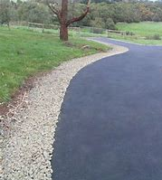
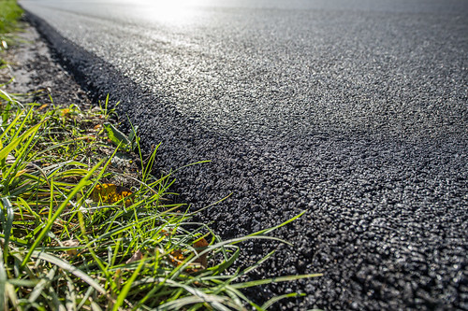
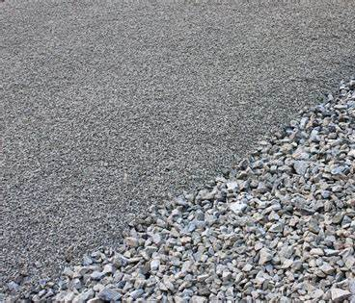
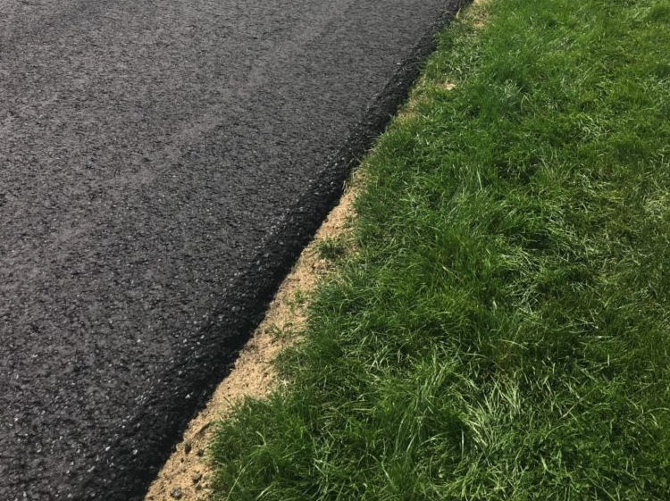
Appendix
Re-surfacing Concept
Track Surface
Existing unbound track to be shaped and re-graded to 3.5m wide and reduced to approximately 50mm below existing levels as preparation for Tarmac surface Apply tarmac surface to 3.5 metres wide: - cambered surface to shed water - minimum of 60mm thick - surface will not deteriorate short term - easily repairable (patched) if required Total accessible width between residential boundaries and the timber bollards (where applicable) will be approximately 5m (min 0.3m scalping + 3.5m tarmac + 1m bollards) Join with Station Road, Concrete Strips and Southside Track East Compacted Asphalt Scalping's to connect tarmac surface and residential boundaries: - assists with drainage - evens out the variance of heights and distances between dwellings and track
Timber Bollards
Village Green
Restore Grass Edge
Approx : 1 metre
Tarmac Surface
Width : 3.5 metres
Asphalt Scalping's
Width & Depth : variable
Residential Frontage
Gardens, Walls & Driveways at varying heights from track
Images of Surfaces are for illustration purposes only
11

Slide 12
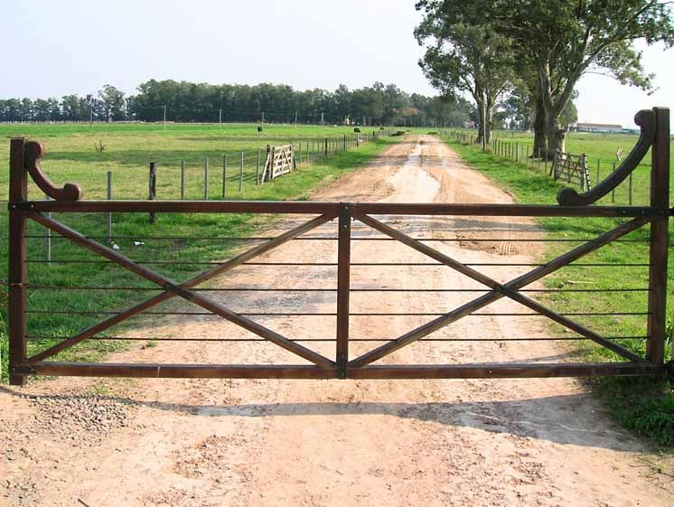
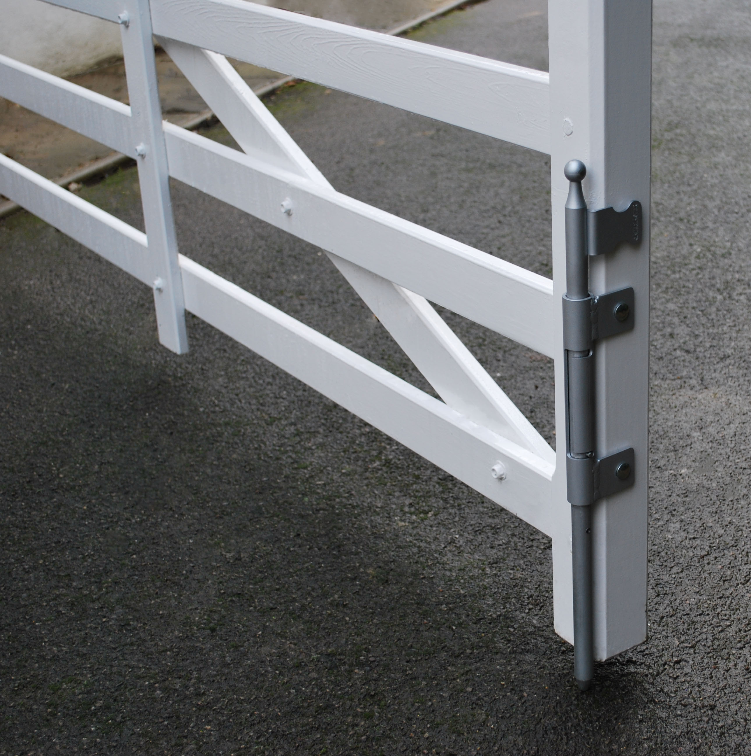
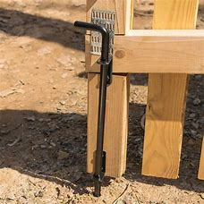
Appendix
Vehicle Barrier Concept
Vehicle Barrier
Barrier is required to prevent vehicles using the track as a cut through to Station Rd/Plough Rd Design of Barrier to be agreed The Barrier will be closed and lockable using ground anchor drop bolt If ever locked, the Parish Clerk will have access to open the barrier by arrangement or in the event of an emergency Proposed position of the Barrier is outside “Chase End” and will swing open/close like a gate not up/down The Barrier will not be the full width of the track, allowing pedestrian and mobility access along the track surface
“CHASE END”
PEDESTRAINS
Images of Barriers are for illustration purposes only
12

Slide 13
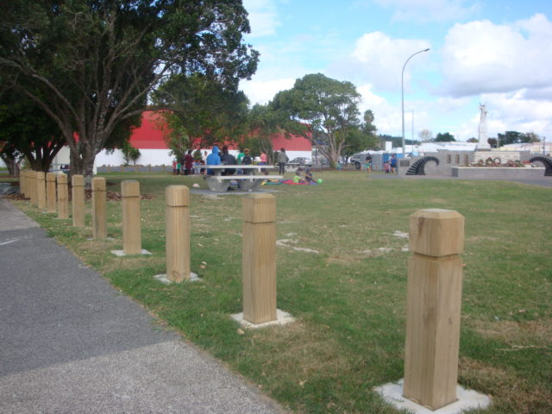
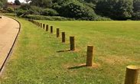
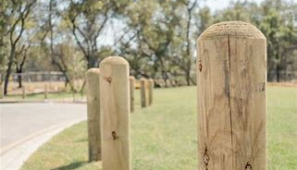
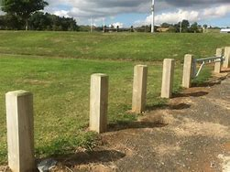
Appendix
Timber Bollards Concept
Timber Bollards
To be spaced at 1.8m intervals to prevent vehicles from driving onto the green and deteriorating the grass surface Along with the vehicle barrier, deters vehicles from using the track as a cut through to Station Rd/Plough Rd Selected bollards will be removable to allow vehicle access when required Bollards will run around the existing access to the Village Green at top of Station Road for approximately 90m At this time it is felt unnecessary to run the Bollards for the full length of the track as they are only intended to deter through-traffic
Vehicle turning head
vehicle
barrier
Images of Timber Bollards are for illustration purposes only
13

Slide 14
Appendix
Signage Concept
In parallel to the project surfacing and village green protection, the Parish Council will be discussing the wording and location for appropriate signage: For example;
Parking within the turning head and against the vehicle barrier will be prohibited.
The barrier will restrict through traffic between Station Road and Weeley Road – appropriate signage will be required to help avoid unnecessary.
13

Slide 15
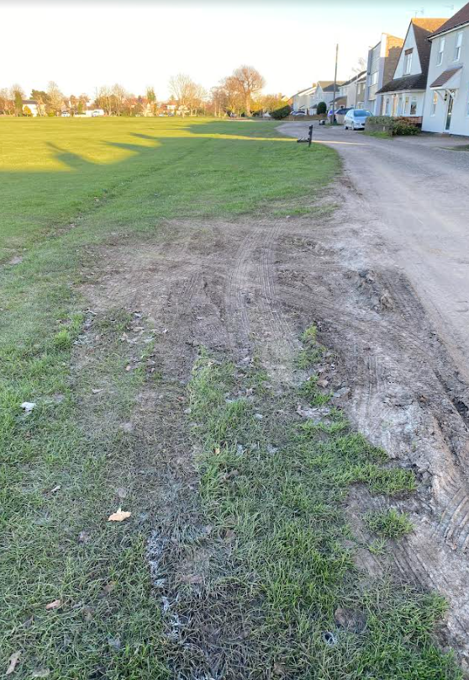
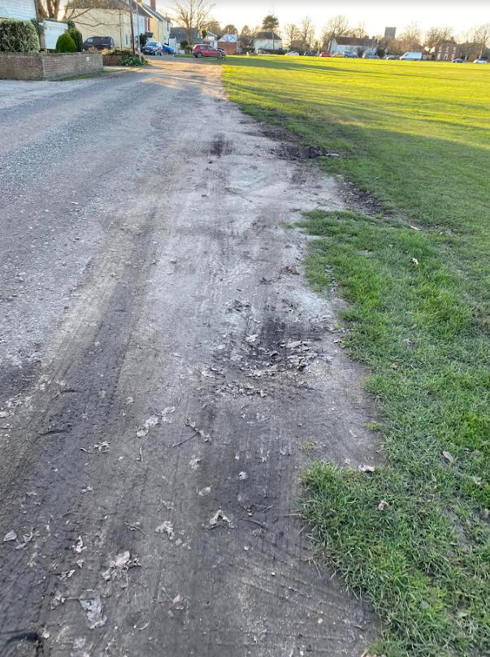
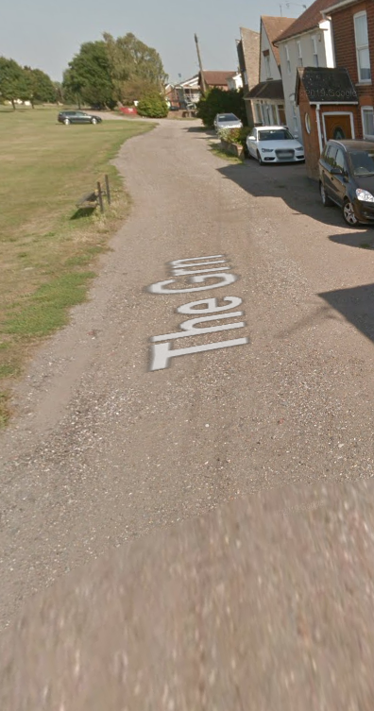
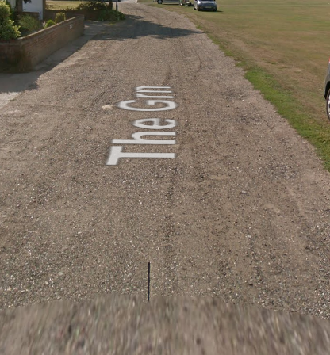
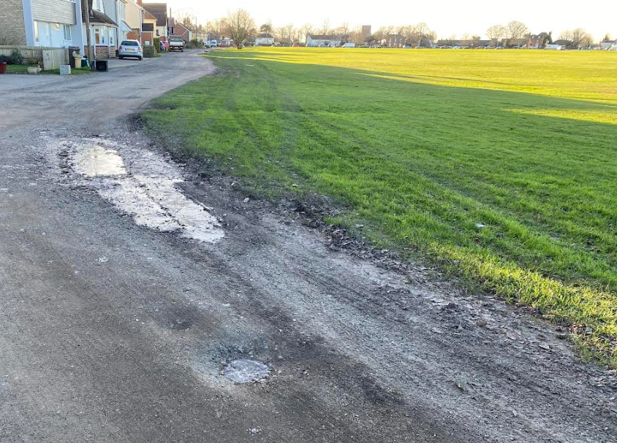
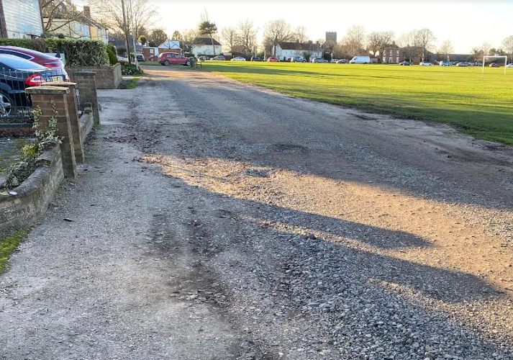
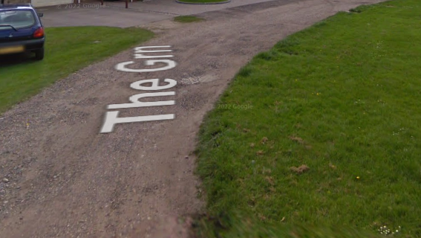
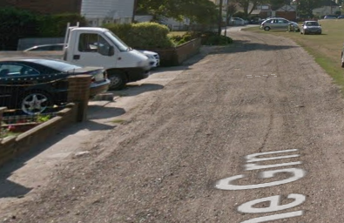
Appendix Photographs : Southside Track West; Village Green deterioration
January 2024 | September 2016
14

Slide 16
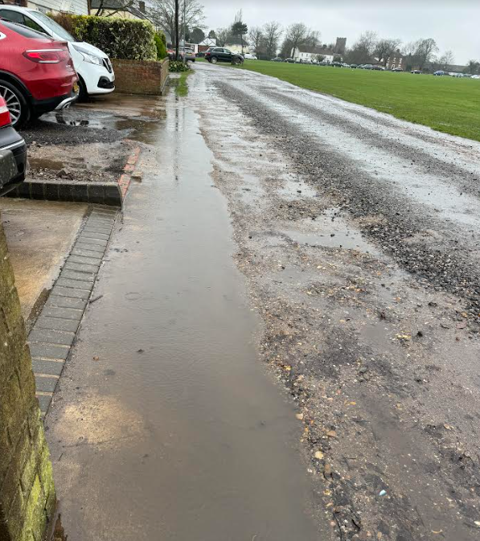
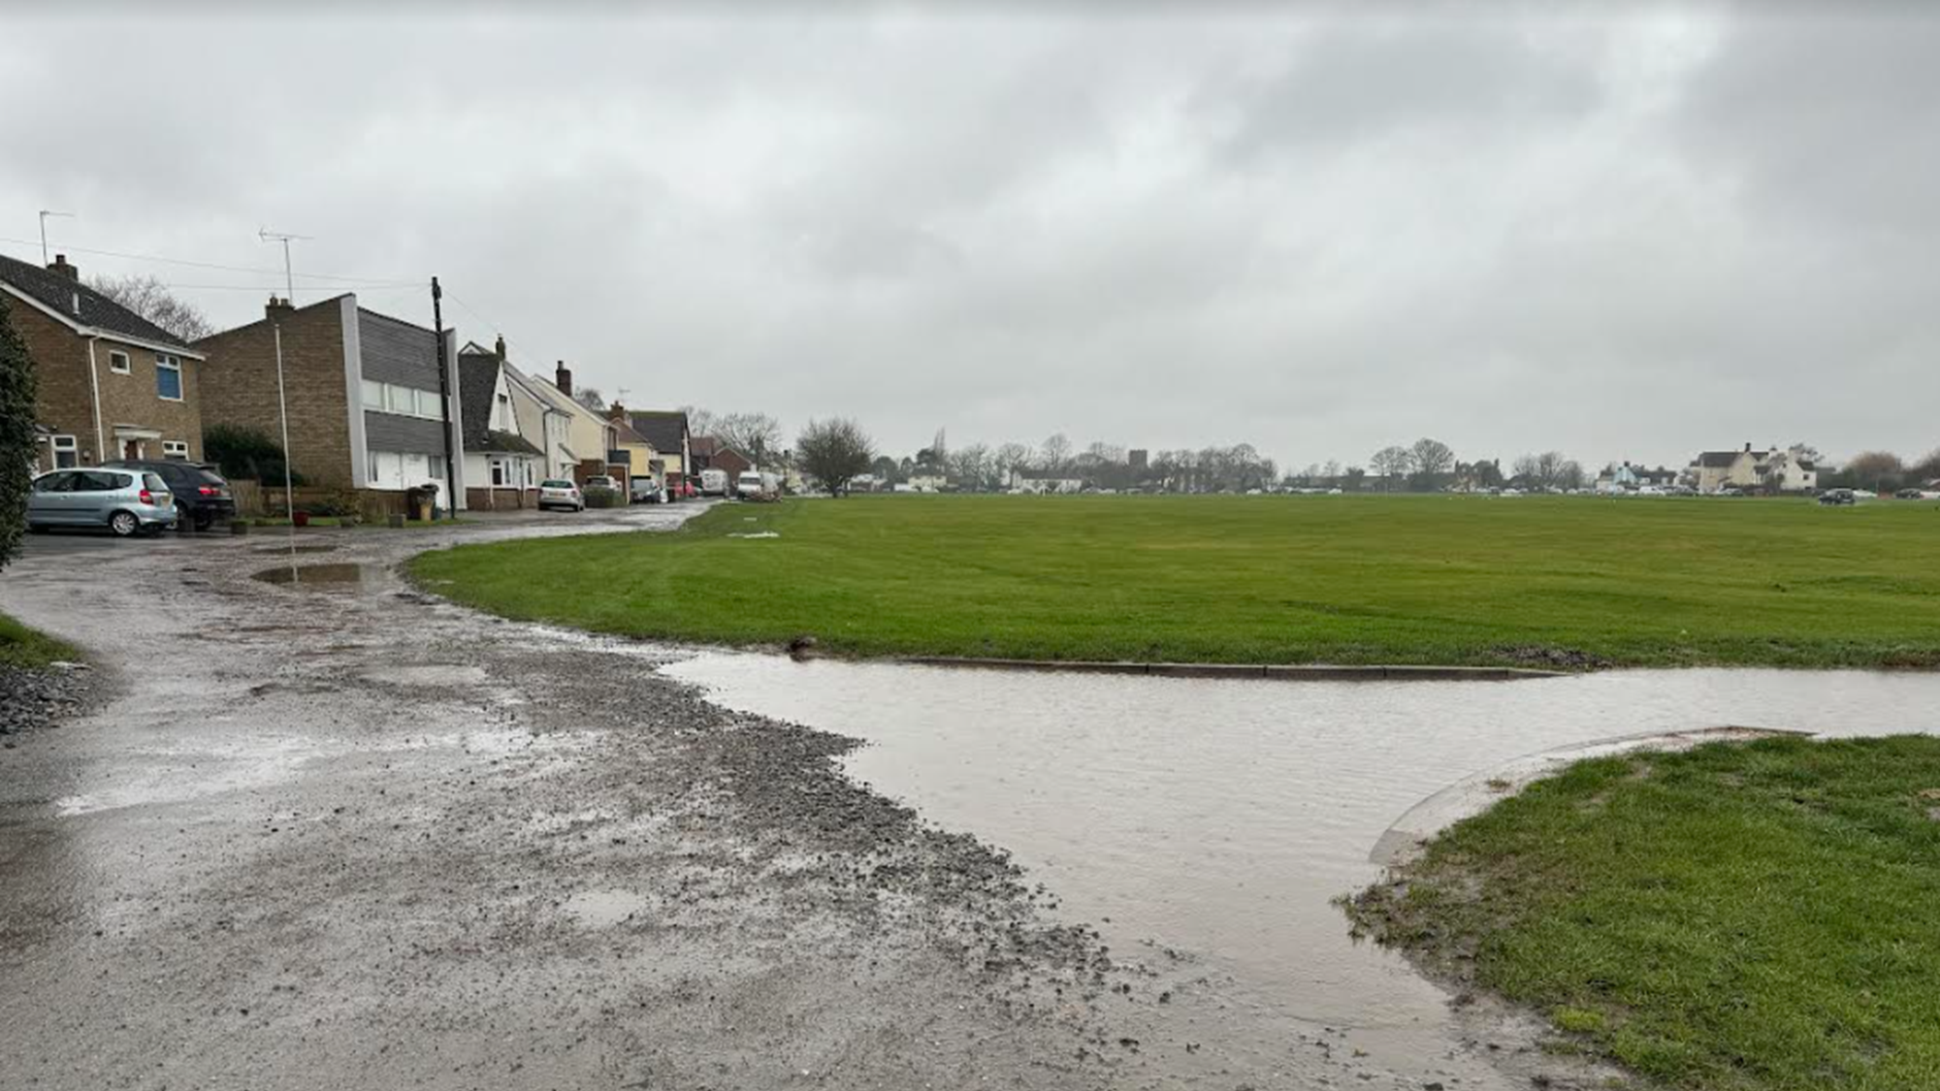
Appendix Photographs : Southside Track West
February 2024
Uneven surfaces collecting rain water
Uneven surfaces collecting rain water
Flooding at Concrete Tracks
15

Slide 17
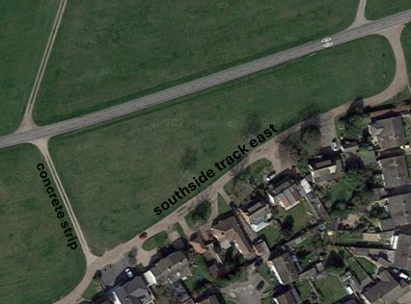
Appendix Southside Track East
Proposed Future Project
If the Southside West track project is successful, then the Parish Council will seek to propose future discussion to: “close-off” the eastern end of the track to Weeley Road and return it to grass Access from Weeley Rd to dwellings on Southside track east would be via the concrete strips By reducing the access, the eastern end of southside track should receive less traffic and the expectation is that the surface would hold up much better/longer Pedestrian/mobility access from the eastern end of the track into Birch Ave will be reviewed as part of the future proposal
WEELEY Rd
Diagram is for illustration purposes only – no decisions are being made at this point
16

